Slide 1
Capstone Project
Company Bankruptcy Prediction
Submitted by:
Avanish Dixit

Slide 2
Flow of the Presentation
Introduction
Data Preparation
EDA
Algorithms Implementation
Evaluation matrices
Conclusion

Slide 3
Introduction
Bankruptcy prediction is always a topical issue. The activities of all business entities are directly or indirectly affected by various external and internal factors that may influence a company in insolvency and lead to bankruptcy. It is important to find a suitable tool to assess the future development of any company in the market.
Objective: The objective of this Capstone Project is to create a model for predicting potential bankruptcy of companies using suitable classification methods, and to evaluate the results of the methods used

Slide 4
Methodology: Machine Learning (ML) Classification Algorithms (Supervised ML Model)
Dataset Summary:
The data were collected from the Taiwan Economic Journal for the years 1999 to 2009. Company bankruptcy was defined based on the business regulations of the Taiwan Stock Exchange.
It has 6819 rows and 96 columns
The values of independent features are numerical and the dependent feature contains Binary value(1/0)
The dataset has broadly contains the ratios between the different financials and some features contain the real values.

Slide 5
Data Preparation
The database has the following features:
The dataset contains total of 96 features. The names are given below.
Bankrupt?', ROA(C) before interest and depreciation before interest, ROA(A) before interest and % after tax, ROA(B) before interest and depreciation after tax, Operating Gross Margin, Realized Sales Gross Margin, Operating Profit Rate, Pre-tax net Interest Rate , After-tax net Interest Rate,' Non-industry income and expenditure/revenue, Continuous interest rate (after tax), Operating Expense Rate, Research and development expense rate, Cash flow rate, Interest-bearing debt interest rate', ' Tax rate (A), Net Value Per Share (B), Net Value Per Share (A),' Net Value Per Share (C), Persistent EPS in the Last Four Seasons, Cash Flow Per Share, Revenue Per Share (Yuan ¥), Operating Profit Per Share (Yuan ¥), Per Share Net profit before tax (Yuan ¥), Realized Sales Gross Profit Growth Rate,
Operating Profit Growth Rate, After-tax Net Profit Growth Rate,' Regular Net Profit Growth Rate, Continuous Net Profit Growth Rate,
Total Asset Growth Rate, Net Value Growth Rate, Total Asset Return Growth Rate Ratio', ' Cash Reinvestment %, Current Ratio, Quick Ratio, Interest Expense Ratio, Total debt/Total net worth, Debt ratio %, Net worth/Assets, Long-term fund suitability ratio (A), Borrowing dependency, Contingent liabilities/Net worth, Operating profit/Paid-in capital, Net profit before tax/Paid-in capital, Inventory and accounts receivable/Net value, Total Asset Turnover, Accounts Receivable Turnover, Average Collection Days, Inventory Turnover Rate (times), Fixed Assets Turnover Frequency, Net Worth Turnover Rate (times), Revenue per person, Operating profit per person, Allocation rate per person, Working Capital to Total Assets, Quick Assets/Total Assets, Current Assets/Total Assets, Cash/Total Assets, Quick Assets/Current Liability, Cash/Current Liability, Current Liability to Assets, Operating Funds to Liability, Inventory/Working Capital, Inventory/Current Liability, Current Liabilities/Liability, Working Capital/Equity, Current Liabilities/Equity, Long-term Liability to Current Assets, Retained Earnings to Total Assets, Total income/Total expense, Total expense/Assets, Current Asset Turnover Rate, Quick Asset Turnover Rate, Working capital Turnover Rate, Cash Turnover Rate, Cash Flow to Sales, Fixed Assets to Assets, Current Liability to Liability, Current Liability to Equity, Equity to Long-term Liability, Cash Flow to Total Assets, Cash Flow to Liability, CFO to Assets, Cash Flow to Equity, Current Liability to Current Assets, Liability-Assets Flag, Net Income to Total Assets, Total assets to GNP price, No-credit Interval, Gross Profit to Sales, Net Income to Stockholders Equity, Liability to Equity, Degree of Financial Leverage (DFL), Interest Coverage Ratio (Interest expense to EBIT), Net Income Flag', Equity to Liability.,

Slide 6
Overview of Dataset
It has no ‘NaN’ or ‘Null’ values
It has no duplicate values
‘Bankrupt?’ is a dependent feature.
‘Net income flag’ contains only 1 as a value.
Almost all the features have tailed histogram.
Dependent variable contains 6599 - 0s and 220 - 1s. Hence it is a imbalance dataset.

Slide 7
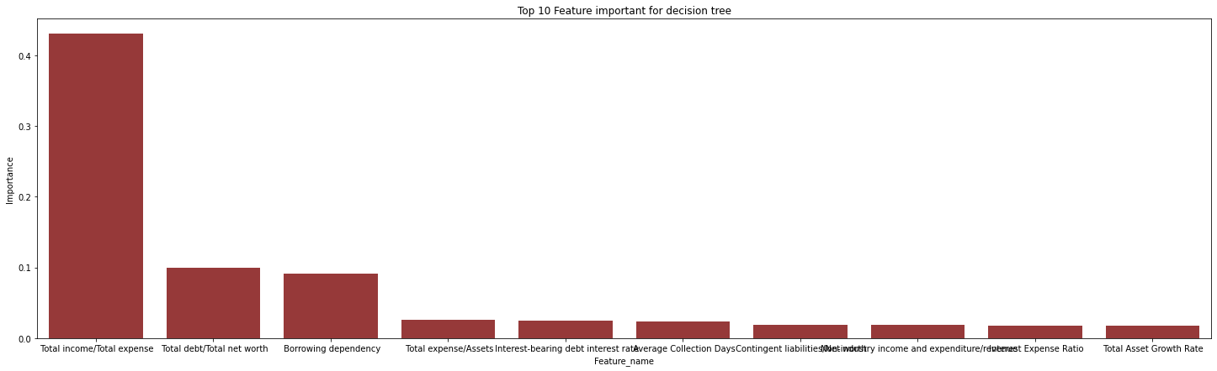
EDA
Plots of the Distribution of Top 3 Features (according to decision tree)

Slide 8
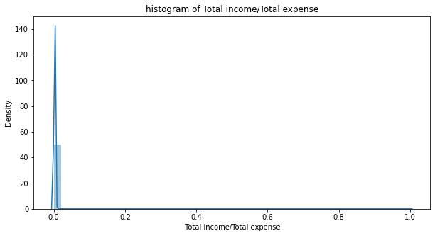
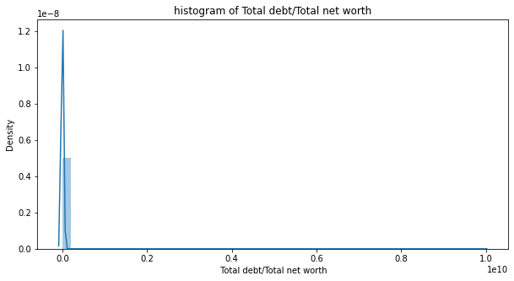
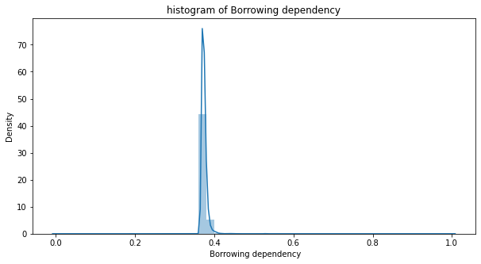
From the above plot we can say, All three are tailed histograms.

Slide 9
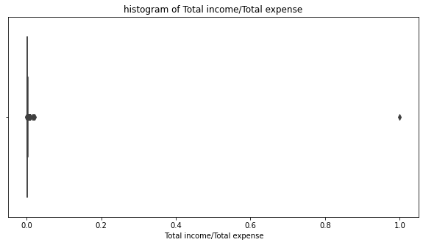
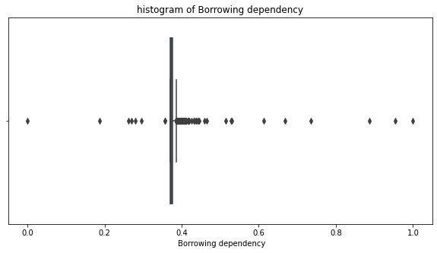
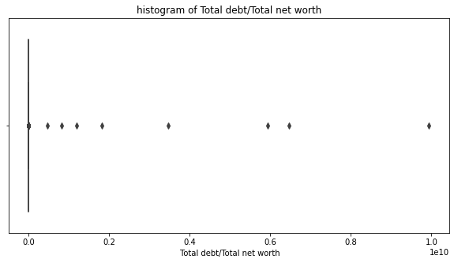
Outlier in top 3 Features
All the three contains outliers.

Slide 10
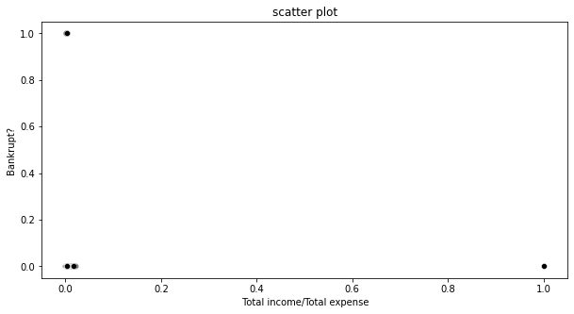
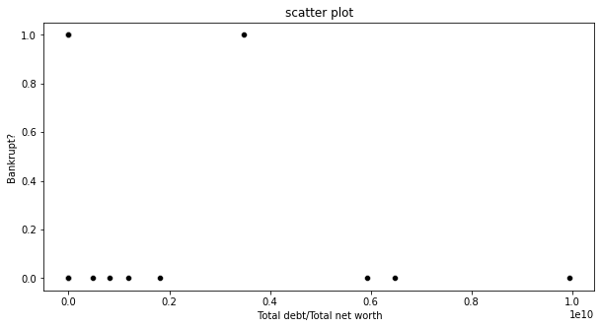
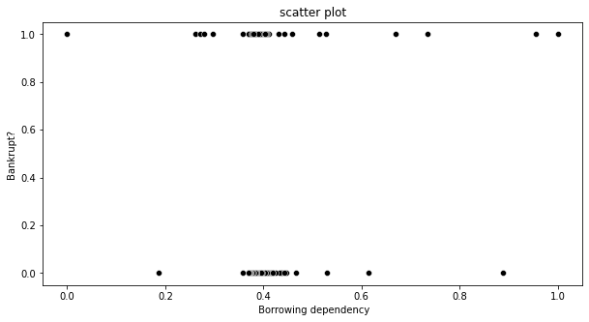
Scatter Plot of top 3 features
Since, our dependent variable is categorical hence scatter plot always contains points on 1 and 0.

Slide 11
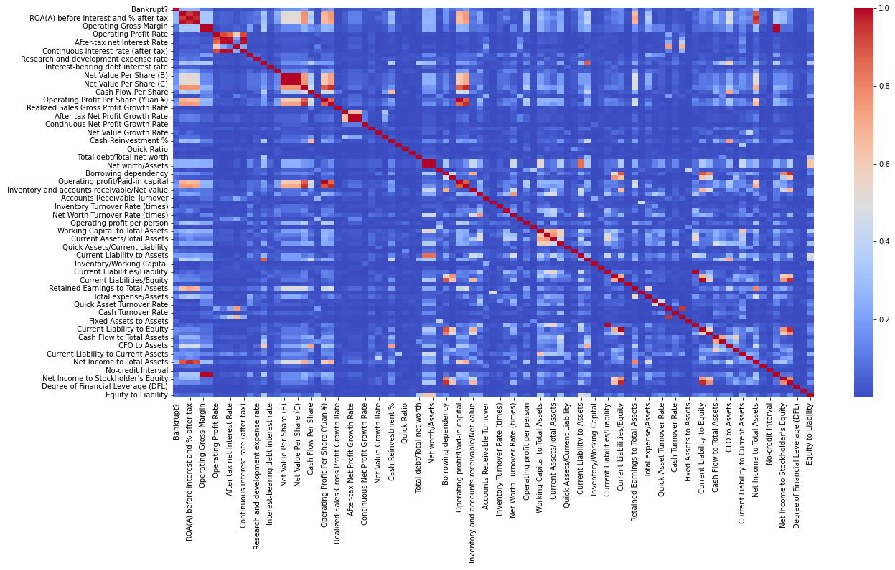
Correlation Heatmap
With the help of heatmap we can easily see that there so many features which are highly correlated.

Slide 12
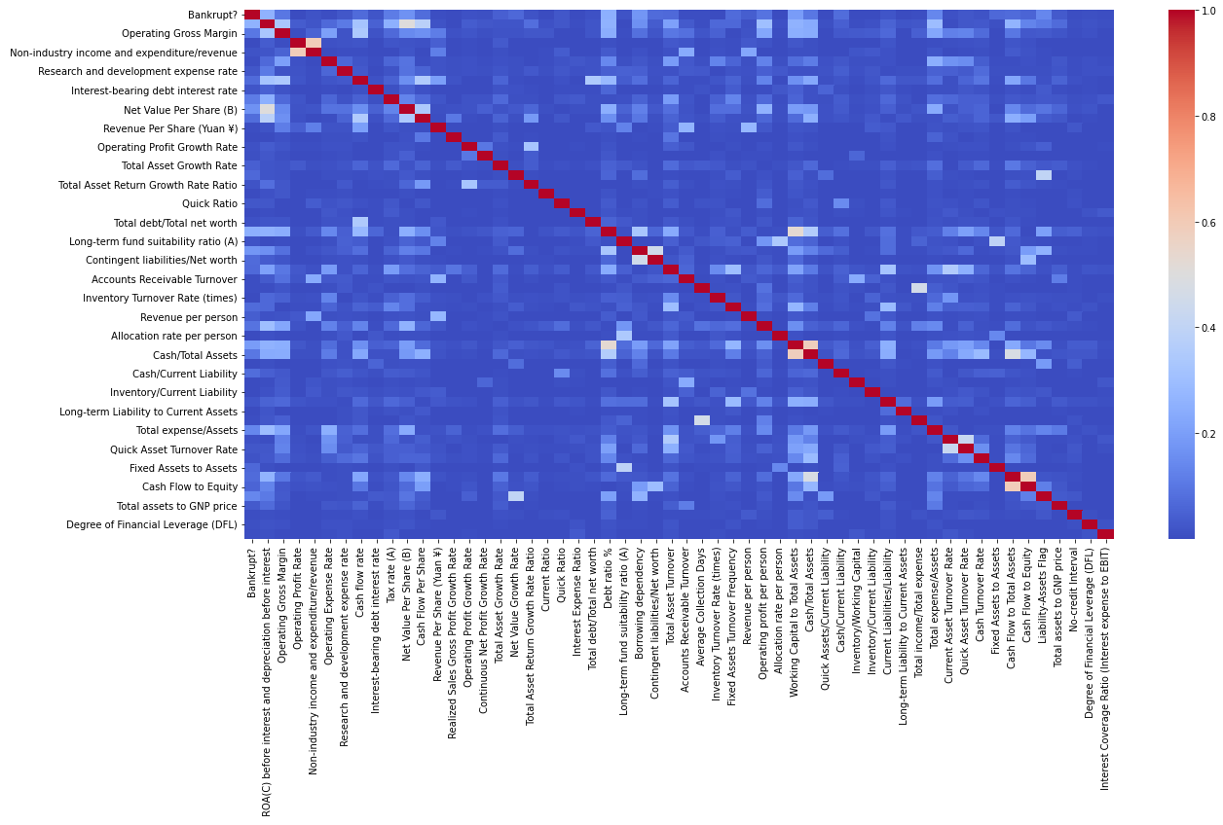
After removing some features, then our dataset is now contain less correlated features.

Slide 13
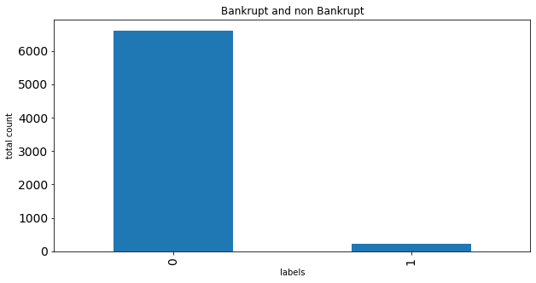
Dependent variable
From this bar graph, we can see that our dataset is highly imbalanced. So, we need to do some resampling technique.

Slide 14
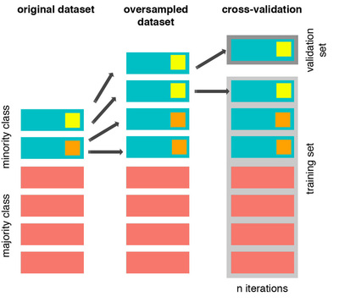
SMOTE(synthetic minority over-sampling technique)
SMOTE is an oversampling technique that generates synthetic samples from the minority class.

Slide 15
Classification Algorithms Implementation
Logistic Regression
Naive bayes classification
K-nearest neighbour classification
Support vector machine classification
Gradient Boosting Machine (GBM) classification
XGboost
Decision Tree
Random Forest

Slide 16
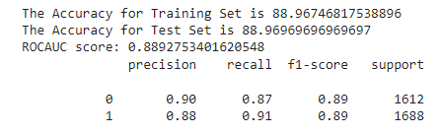
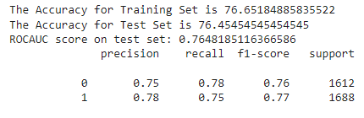
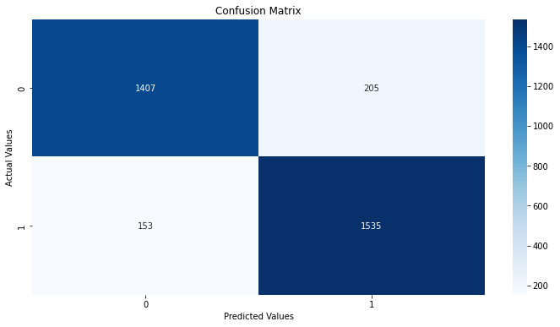
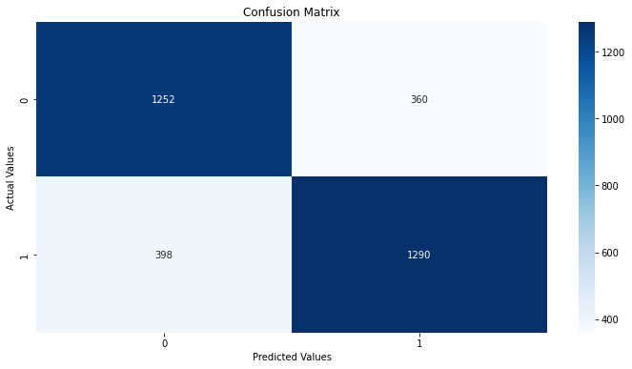
Logistic Regression
Naive bayes classifier

Slide 17
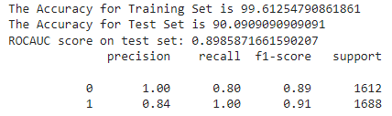
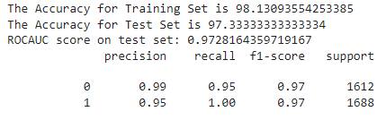
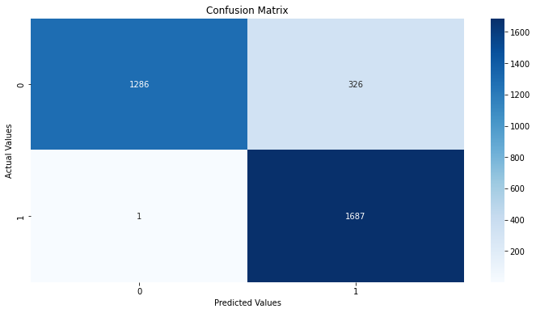
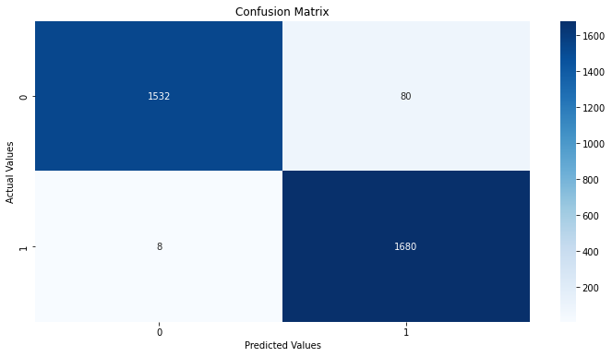
KNN
SVM

Slide 18
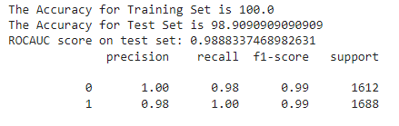
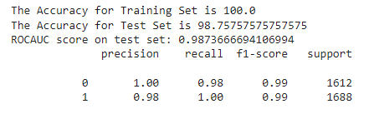
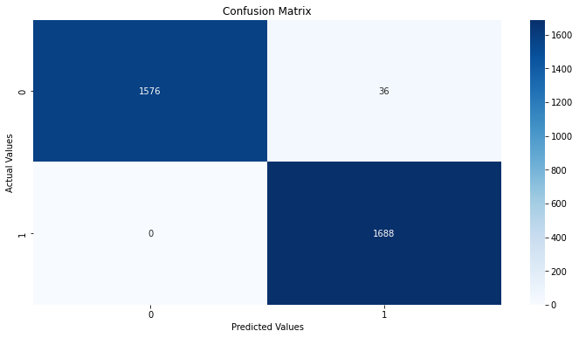

GBM
XGboost

Slide 19
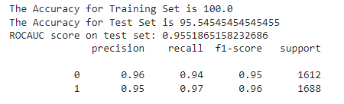
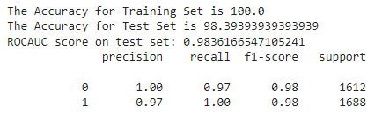


Decision Tree
Random forest

Slide 20
Challenges
The Dataset is large.
The project requires some domain knowledge.
Dataset is highly imbalance.
Do not fall in the trap of high accuracy.
Many features are correlated so the feature selection was challenging.
Different algorithms were giving different performance.

Slide 21
Conclusion
After the treatment of the outliers, checking for the null values, duplicate values, did EDA on the given dataset.
After this i got to know that dataset is highly imbalance. So, i used SMOTE resampling technique.
Then I apply different Classification models on dataset like Logistic regression, Naive bayes classifier, KNN, SVM, decision tree, randomforest, GBM, XGboost.
I got the maximum ROC AUC score in GBM and XGboost models. It is approximately 0.98 and f1 score is 0.99 for predicting the bankruptcy.

Slide 22
Thank
You

